Slide 1
EMPLOYEE DATA ANALYSIS USING EXCEL
STUDENT NAME: RAKSHANA K
REGISTER NO: 312209127
NAAN MUDHALVAN ID: asunm1353312209127
DEPARTMENT: COMMERCE
COLLEGE: ANNA ADARSH COLLEGE FOR WOMEN

Slide 2

PROJECT TITLE
EMPLOYEE ATTRITION ANALYSIS USING EXCEL DASHBOARDS

Slide 3


AGENDA
Problem Statement
Project Overview
End Users
Our Solution and Proposition
Dataset Description
Modelling Approach
Results and Discussion
Conclusion
3/21/2024 Annual Review

Slide 4

PROBLEM STATEMENT
The project is based on employee attrition analysis using excel dashboards. It is a valuable tool for organizations to understand and manage employee turnover.
Employee attrition dashboards is helpful to find out the attrition rates during the period.
And also helpful to monitoring and reporting the future attrition rates

Slide 5

PROJECT OVERVIEW
Using excel dashboards we are calculated employee attrition rate in an company during the period In various circumstances like based on job role , based on gender, based on age group, and based on performance of an employee.

Slide 6


WHO ARE THE END USERS?
EMPLOYERS
EMPLOYEES
OWNER OF THE COMPANY

Slide 7


OUR SOLUTION AND ITS VALUE PROPOSITION
FILTERING - REMOVING MISSING VALUES
POWER QUERY - CHANGING TYPE,ADDING CONDITIONAL COLUMN
PIVOT TABLE - SUMMARY OF EMPLOYEE ATTRITION
CHARTS – FINAL REPORTS

Slide 8

Dataset Description
https://www.Kaggle.com/models
Using this website we downloaded the datasets for monitor the employee attrition rates in a company for a particular period its is time saving process. Using these set of values we are able to find out why employee are leaving the companies based on the reasons.

Slide 9

THE "WOW" IN OUR SOLUTION
Used slicer in pivot table – To monitor attrition rates of employees in a easy way.
Used conditional column in power query – To sort and filter the data of employee.
9

Slide 10

MODELLING
STEP 1 :
To download the employee dataset using Kaggle websites or any other websites.
Step 2 :
Using the dataset create the table and convert the table into power query
Data tab – From table – table name – conditional column(to sort and filter) – transform data to excel.
10

Slide 11
MODELLING
STEP 3 :
create pivot table using pivot table option in insert tab. And sort the data which are needed.
Step 4 :
Using the sorted data create charts and place in the dashboards place which are created using shapes, charts and data.
11

Slide 12
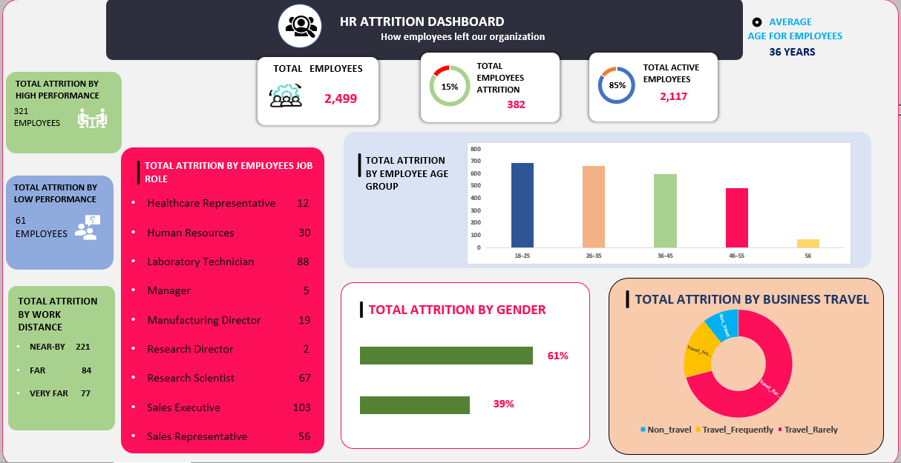
RESULTS
12

Slide 13
Conclusion
Based on the employee dataset the employees are attrition basis on the gender and age groups.
And also for job satisfaction due to unfulfilling work, poor management are lead to high attrition in a companies.
Insufficient work life balance can drive employees to seek jobs that offer more flexibility or better personal time management.
Career growth opportunities are also a main reasons for attrition rates.

